Slide 1

Comparative Study Analysis of Naive Bayes, Logistic Regression, SVM for Emotion Detection Through Text
By Ranjana Silwal (London Met ID: 23050372, Section: C9)
Module Code and Title: CU6051NI Artificial Intelligence
Tutor: Mr. Binod Bhattarai

Slide 2
Presentation Agenda: Unveiling the AI Journey
01
02
03
Introduction
AI Concepts Used
Research Evidences
Setting the stage for our exploration of AI in emotion detection.
A deep dive into the foundational AI principles employed.
Supporting our methodology with credible findings and insights.
04
05
06
Reason to Select Topic
Solution Explanation
Achieved Results
Understanding the motivation behind this critical study.
Detailing the implemented approach and its components.
Presenting the outcomes and performance metrics of our models.
07
08
09
Real-World Impact
Pseudocode & Flowchart
Conclusion
Exploring the practical applications and societal benefits.
Visualizing the logic and flow of our system.
Summarizing key findings and future directions.

Slide 3

"Emotions are crucial source of information and learning."
— Joseph Ledoux

Slide 4

Introduction
Artificial Intelligence (AI) is the capability of performing tasks that typically require human intelligence. From learning and problem-solving to perception and decision-making, AI is transforming industries and our daily lives.
This project delves into a specific application of AI: detecting human emotions from textual data. By leveraging advanced machine learning techniques, we aim to understand and categorize the nuanced emotional landscape expressed through written language.

Slide 5
Reason to Select Topic
Complexity of Language: Sarcasm and context make emotion detection a challenging AI problem.
Business Demand: Companies need to understand customer sentiment to improve services.
Mental Health: Potential for AI to detect early signs of depression or anxiety through social media text.

Slide 6

Core AI Concepts Utilized
Machine Learning
Natural Language Processing (NLP)
Supervised Learning
The foundation of our approach, allowing systems to learn from data without explicit programming.
Training models on labeled datasets where desired output is known, enabling accurate predictions.
Techniques for computers to understand, interpret, and generate human language, crucial for text analysis.
Feature Engineering
Model Evaluation
Hyperparameter Tuning
Transforming raw data into features that represent the text's emotional content for model consumption.
Assessing model performance using metrics like accuracy, precision, recall, and F1-score to ensure robustness.
Optimizing model parameters to improve performance, involving systematic experimentation to find the best configuration for each algorithm.

Slide 7
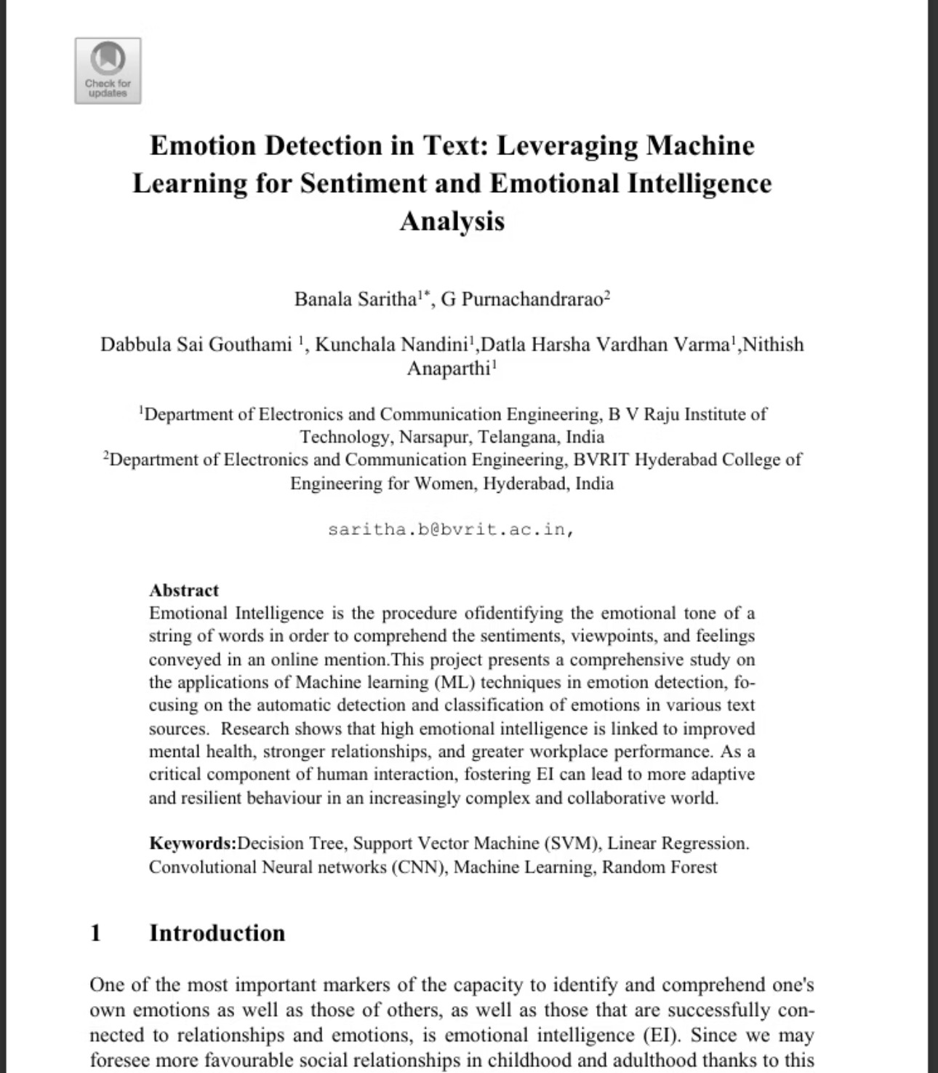
Research Evidence - 1
Focuses on emotion detection from text as part of emotional intelligence and sentiment analysis
Emphasizes the importance of emotion detection in online communication, mental health, and social interactions
Uses traditional machine learning models such as SVM, Logistic Regression, Random Forest, and Decision Trees
Highlights the role of text preprocessing and feature extraction (TF-IDF, Count Vectorization)
Discusses system architecture and workflow diagrams to explain emotion detection pipelines.

Slide 8

Research Evidence - 2
Conducts a comparative study of multiple ML and deep learning models for emotion detection
Compares Logistic Regression, Naïve Bayes, SVM, Random Forest with CNN, LSTM, and BERT
Uses standard evaluation metrics: accuracy, precision, recall, and F1-score
Shows that deep learning models outperform traditional ML, but ML models remain efficient and interpretable
Emphasizes model selection based on application needs, not just accuracy

Slide 9
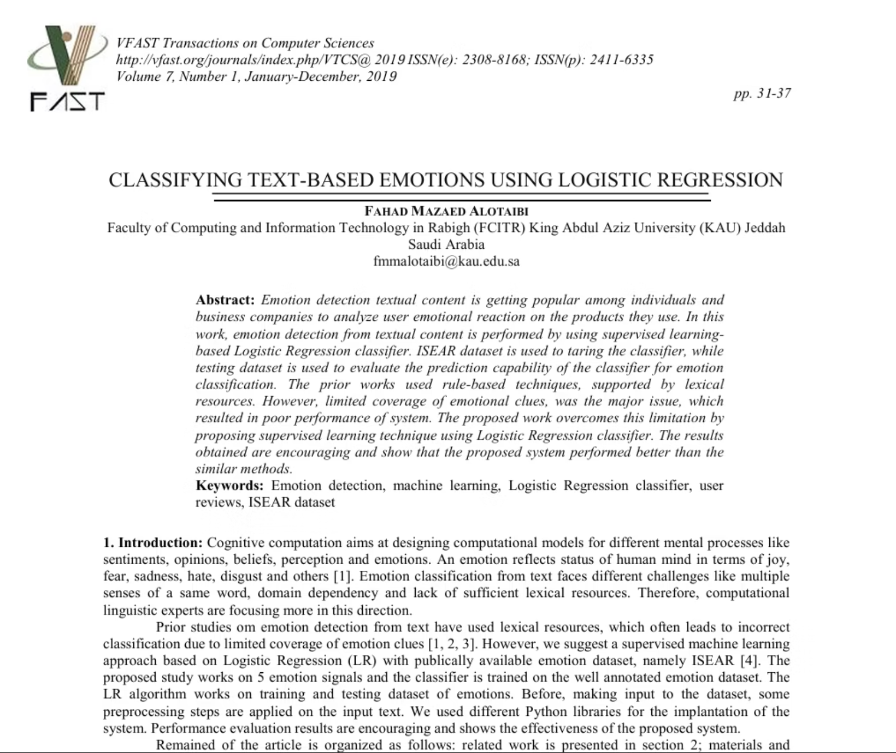
Research Evidence - 3
Focuses specifically on Logistic Regression for emotion classification from text
Uses the ISEAR dataset with supervised machine learning
Highlights limitations of lexicon-based approaches and proposes ML as a better alternative
Explains preprocessing steps and how LR learns emotion patterns from text
Demonstrates that Logistic Regression produces encouraging results for emotion detection

Slide 10
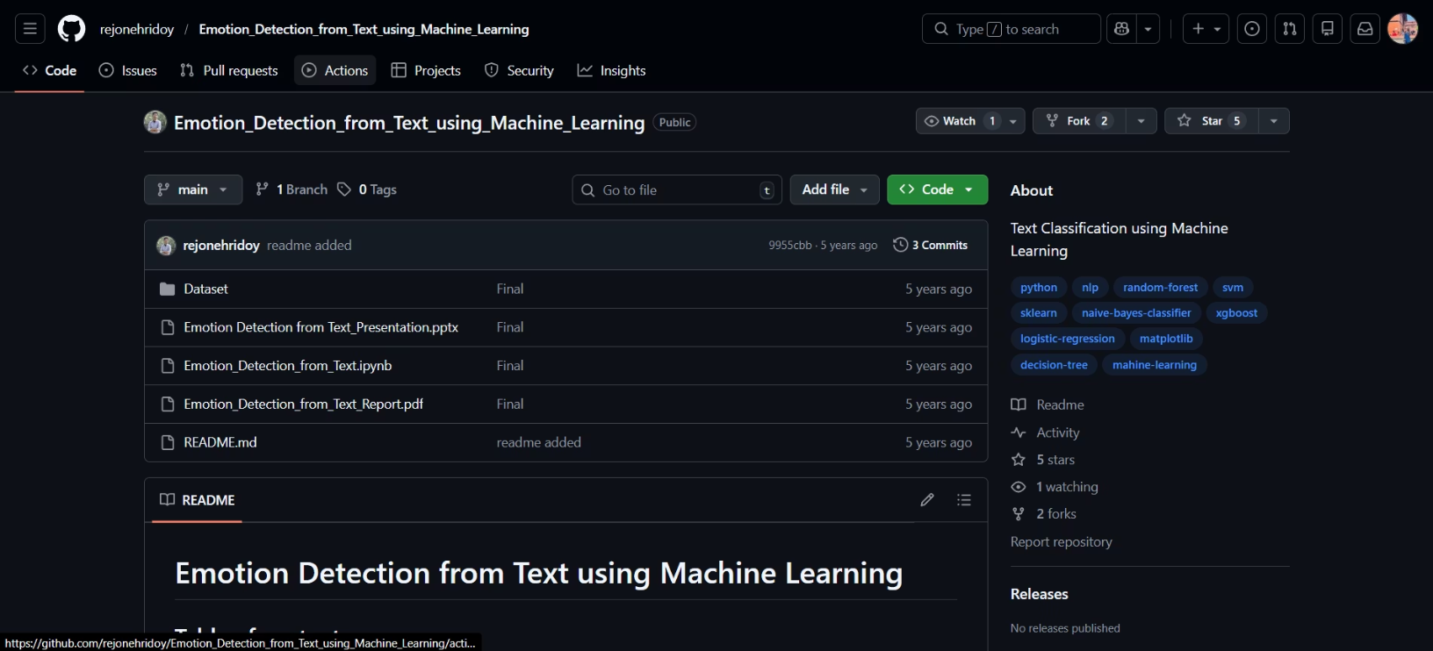
Research Evidence - 4
Presents a full academic project workflow for emotion detection using NLP
Covers data collection, preprocessing, feature extraction (TF-IDF), and model training
Implements and compares SVM, Logistic Regression, Naïve Bayes, Random Forest, and Decision Trees
Uses visual analysis such as confusion matrices, accuracy charts, and emotion distribution graphs
Focuses on experimental evaluation and result comparison, suitable for coursework-level AI projects

Slide 11
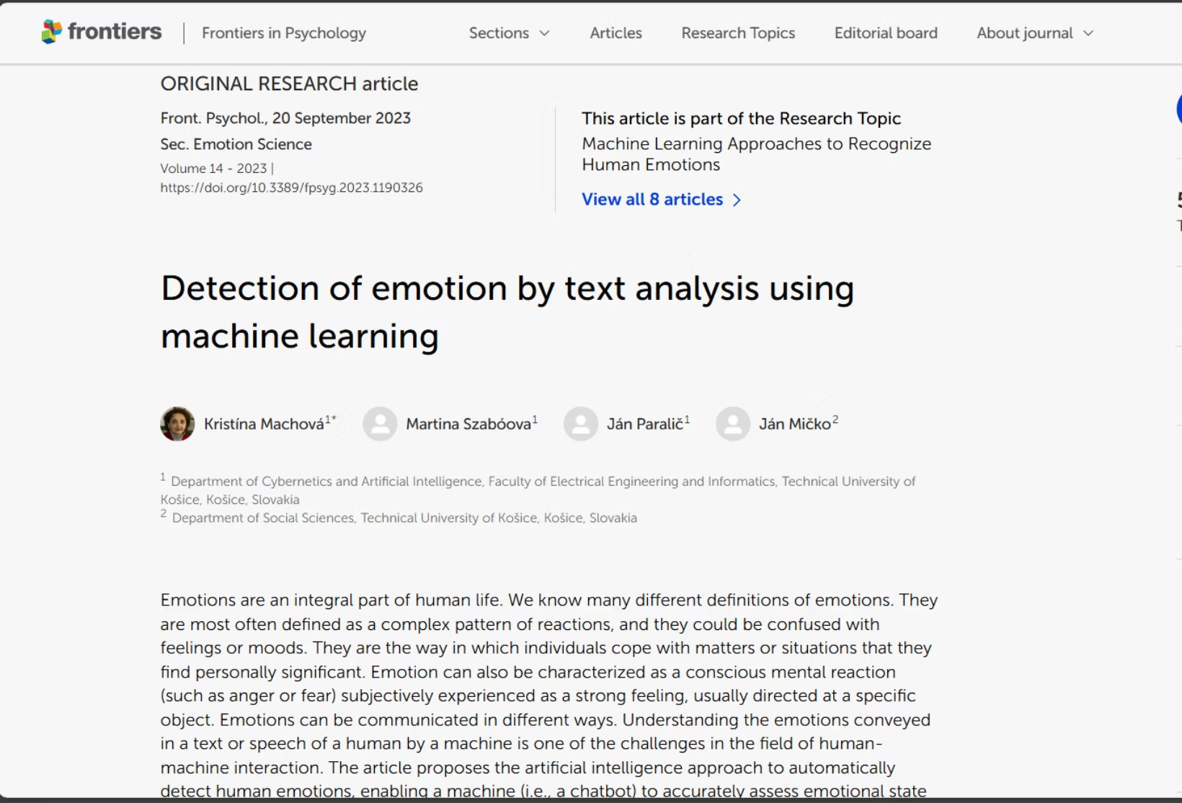
Research Evidence - 5
Provides a comprehensive overview of emotion detection in human–machine interaction
Compares Naïve Bayes, SVM, and Neural Networks for text-based emotion classification
Uses a categorical emotion model (joy, sadness, anger, fear, surprise, etc.)
Demonstrates real-world application through a web application and chatbot
Highlights that full automation of emotion detection is still an open research challenge

Slide 12
Solution Explanation
01
02
Data Collection
Preprocessing
Gathering text labeled with emotions.
Cleaning text, removing stop words, and tokenization.
03
04
Vectorization
Model Training
Using TF-IDF to weight the importance of words.
Feeding data into Naive Bayes, Logistic Regression, and SVM.
05
06
Evaluation
Hyperparameter Tuning
Comparing models using Accuracy, Precision, and Recall, F1-Score and Cross Validation Score
Optimizing the models and making sure they work at their best

Slide 13
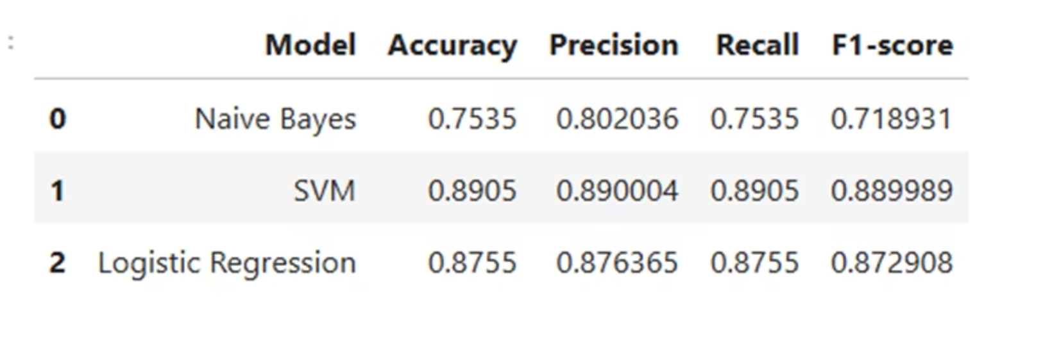
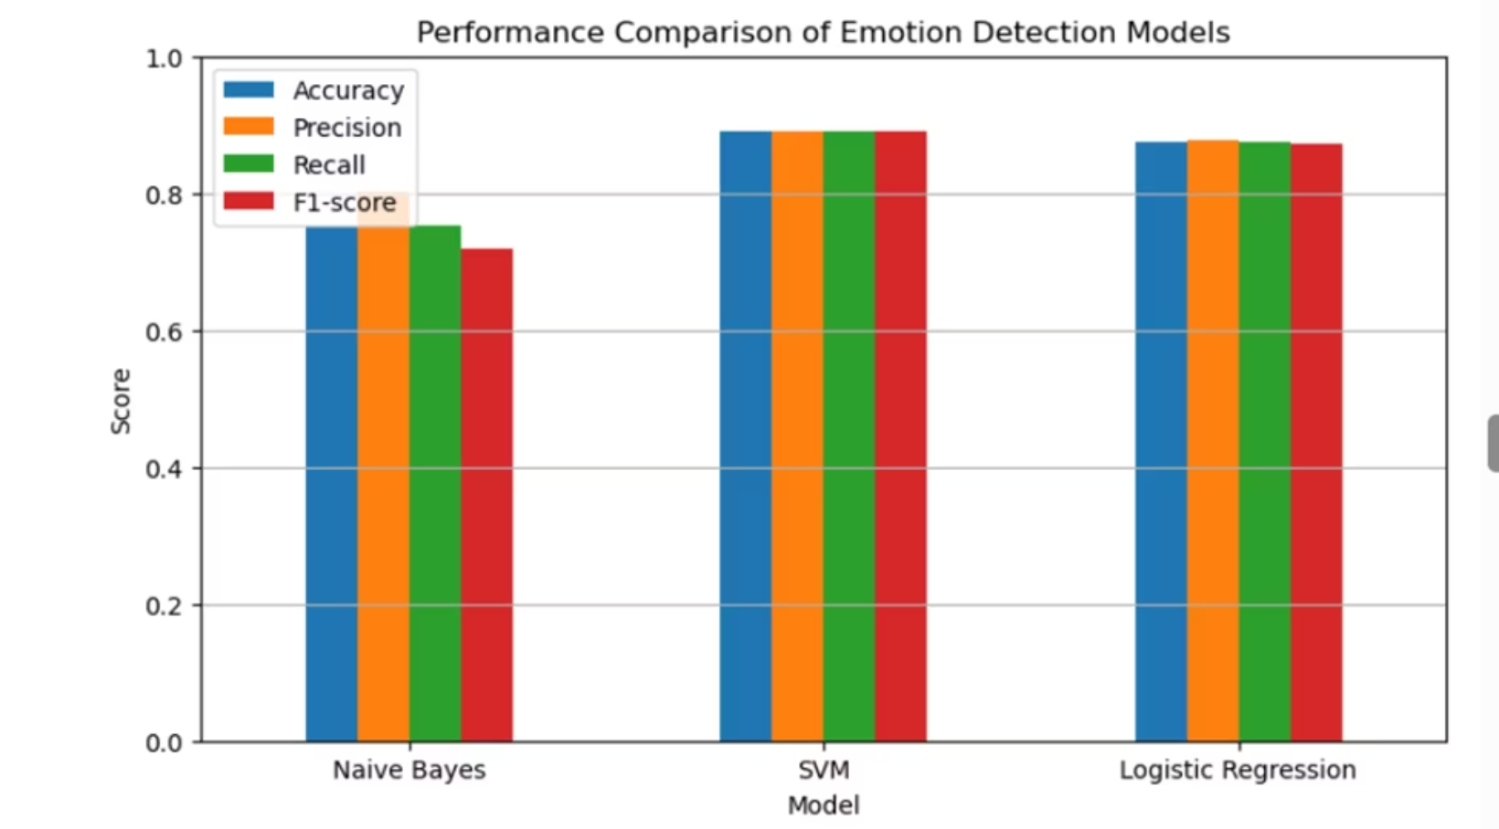
Achieved Results- Accuracy, Precision, Recall & F1-Score

Slide 14
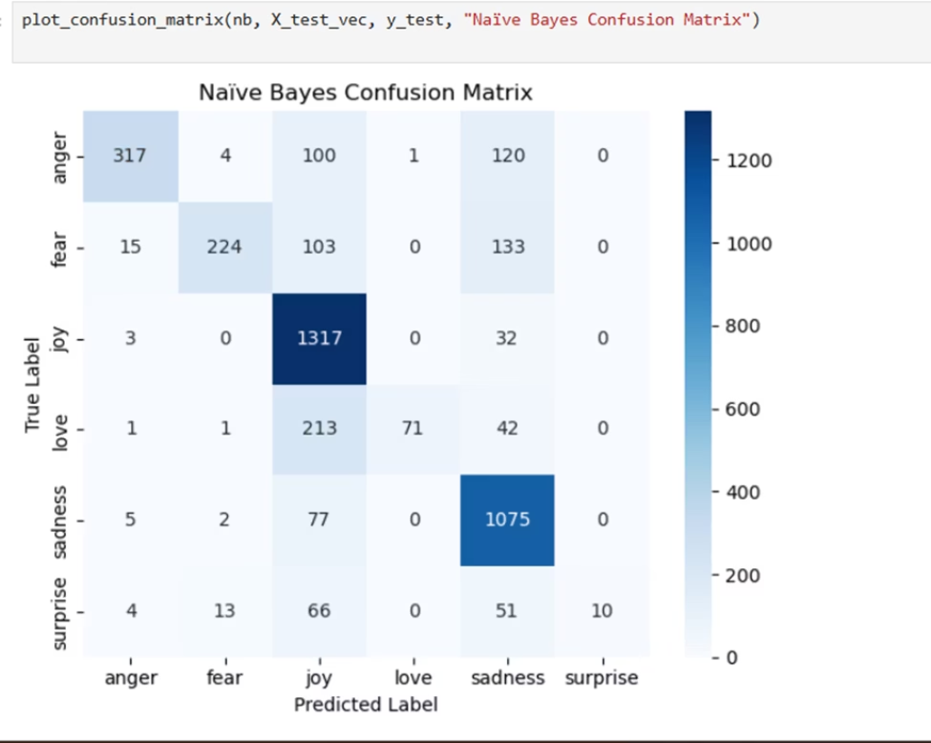
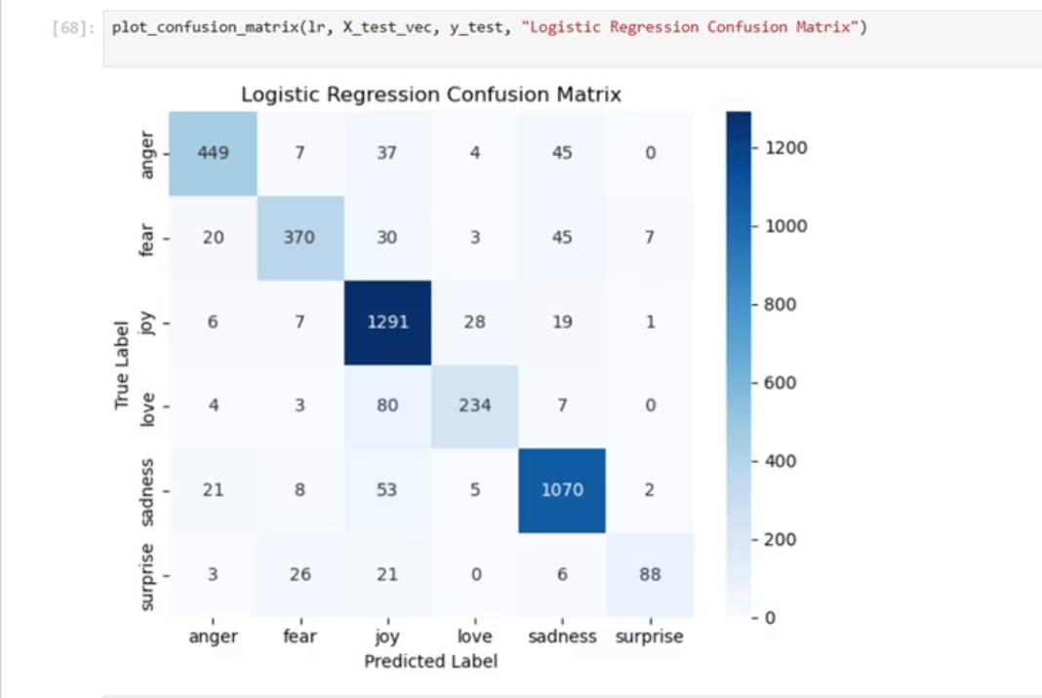
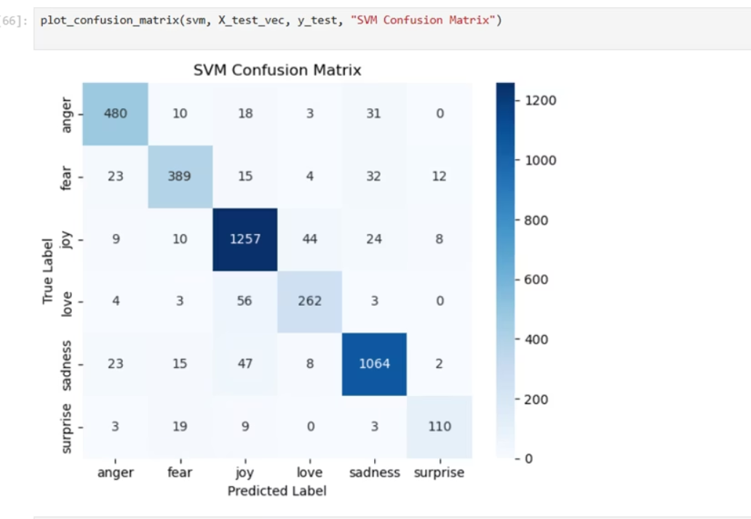
Achieved Results - Confusion Matrix

Slide 15
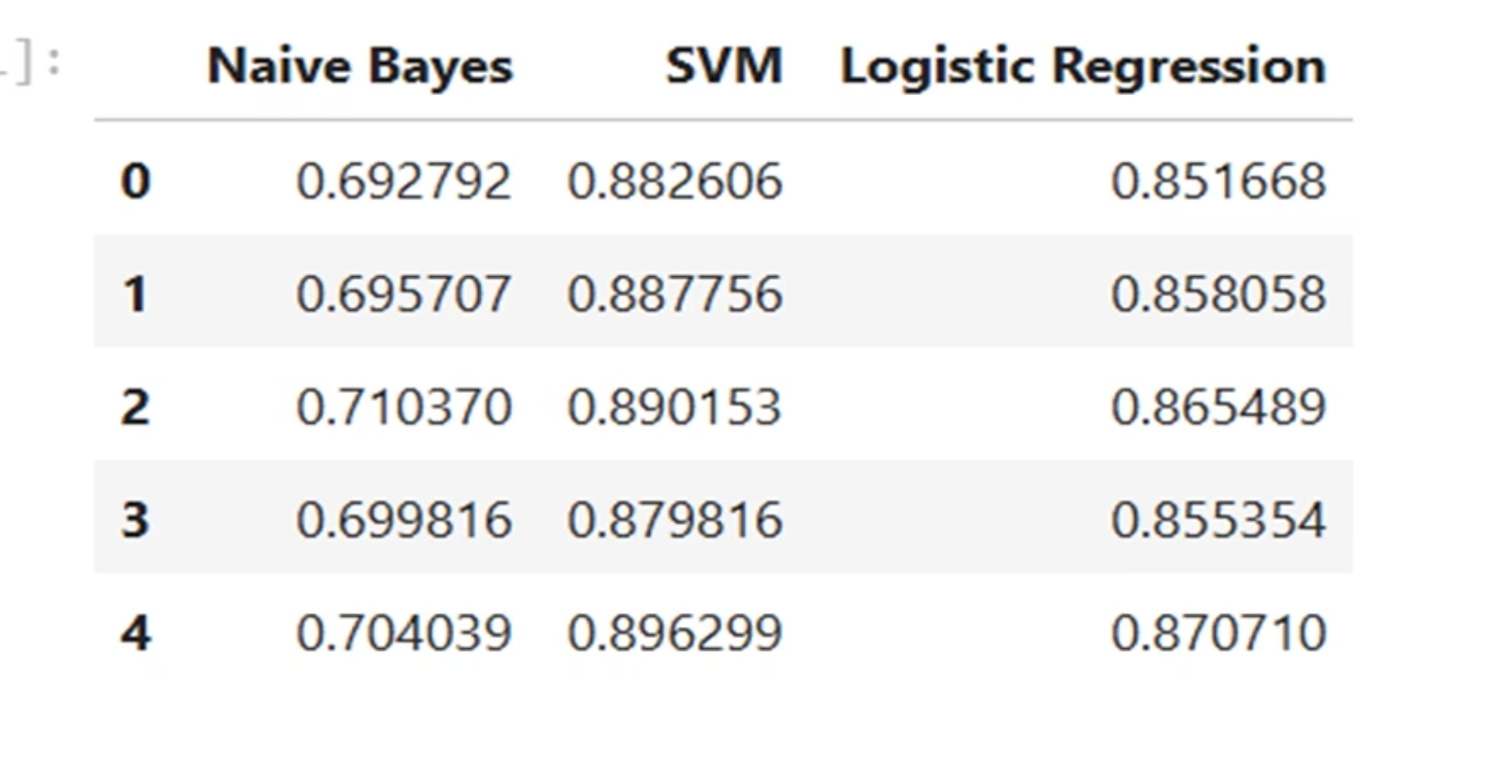
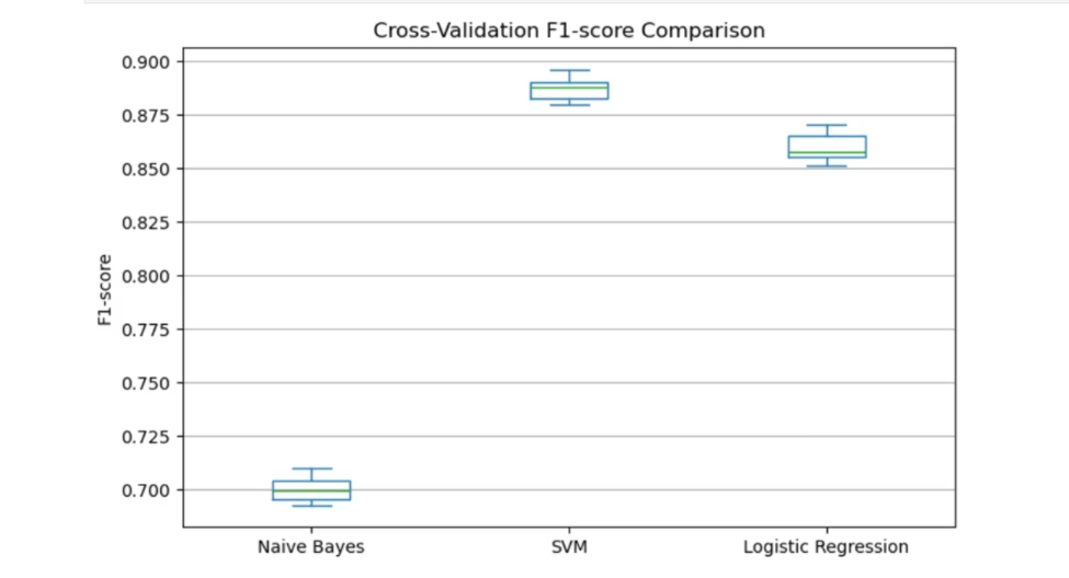
Achieved Results- Cross Validation Score

Slide 16
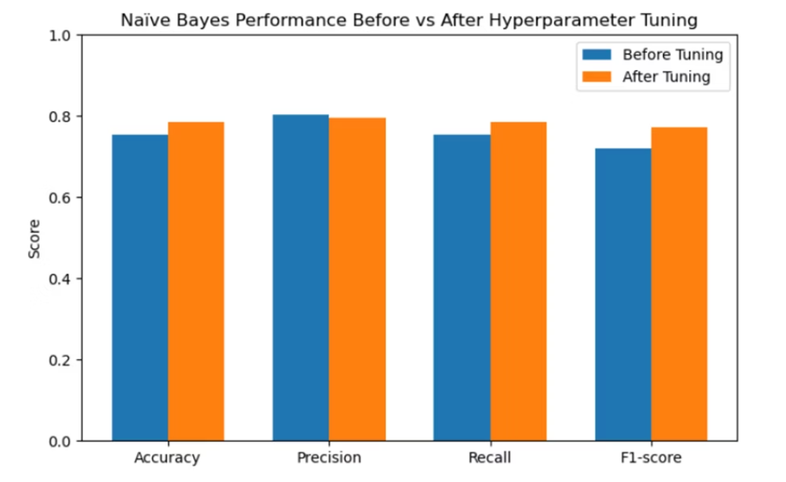
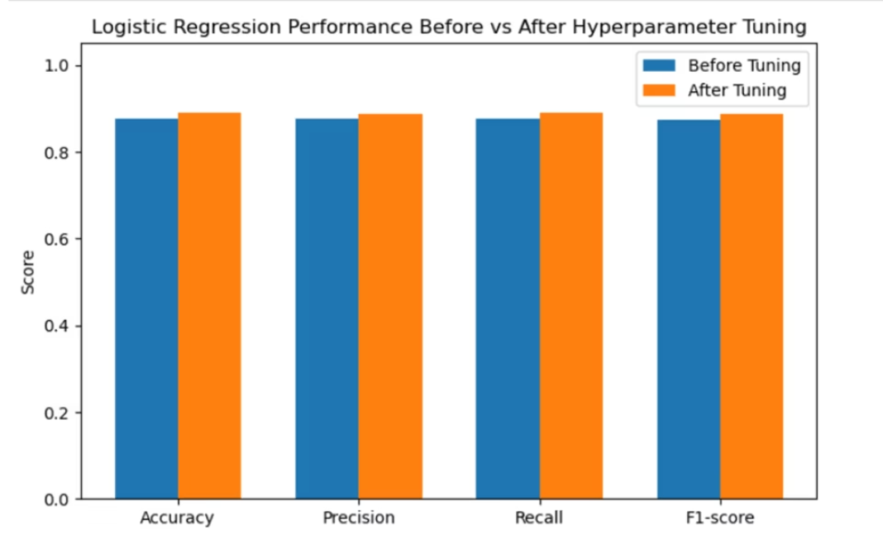
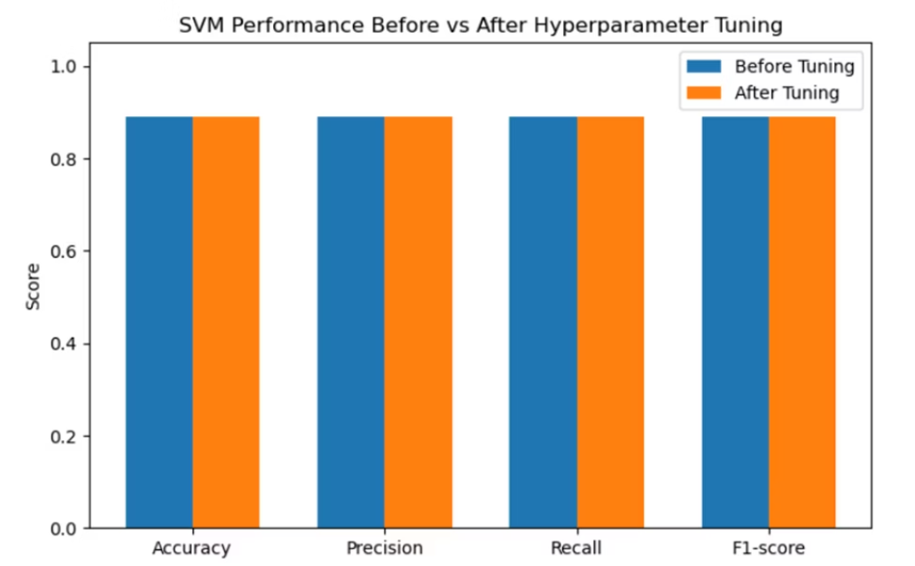
Achieved Results - Hyperparameter Tuning

Slide 17

How It Solves Real - World Problem
Customer Service: Automated sorting of "frustrated" emails to priority support.
Social Media Monitoring: Identifying cyberbullying or toxic behavior in real-time.
Market Research: Analyzing brand perception from thousands of daily tweets.
Healthcare Applications: Supporting mental health professionals by flagging concerning emotional patterns in patient communications.

Slide 18
Pseudocode
BEGIN
LOAD dataset (Text, Emotion)
CLEAN text (Lowercase, remove punctuation/stopwords)
CONVERT text to numbers using TF-IDF Vectorizer
SPLIT data into Training Set (80%) and Testing Set (20%)
FOR each Model (NB, LR, SVM):
TRAIN Model on Training Set
PREDICT labels for Testing Set
CALCULATE Accuracy Score
Evaluate Results
Optimize the models
Compare Results
END

Slide 19
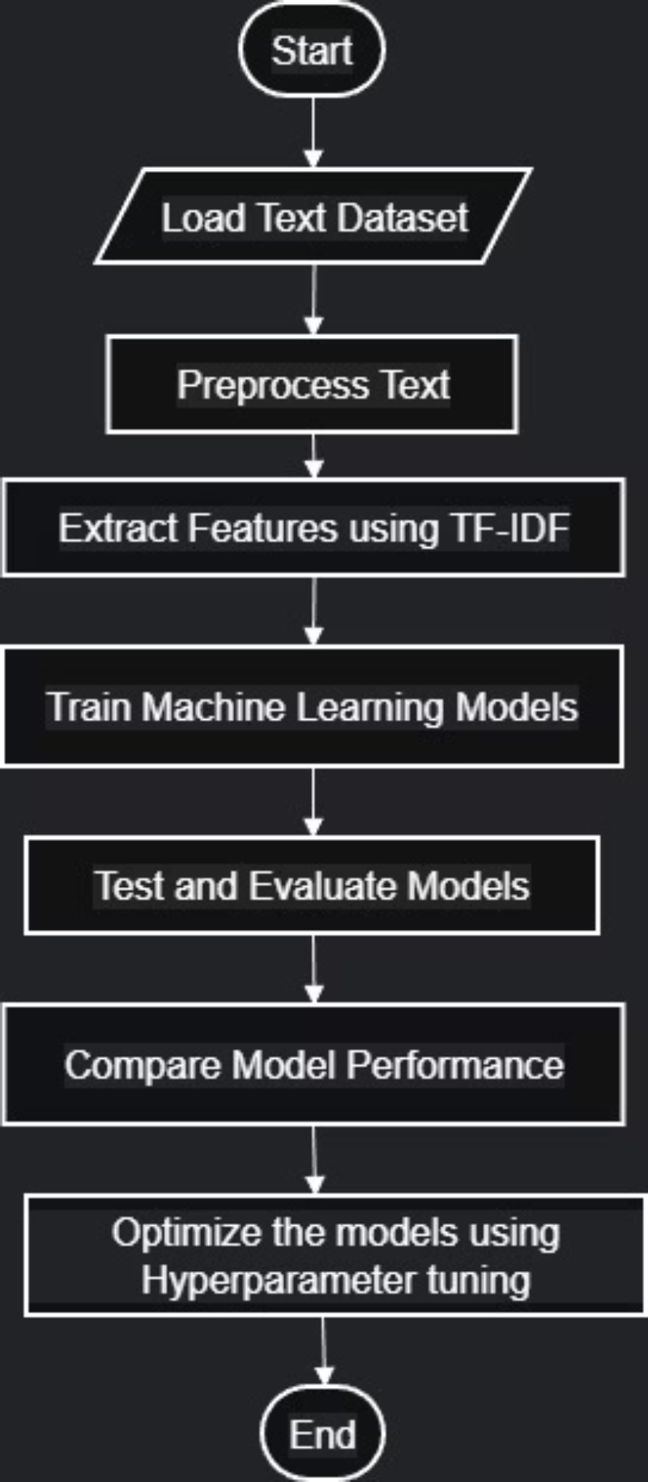
Flowchart

Slide 20
Conclusion
Summary
Future Work
Closing
SVM typically outperformed the others in terms of accuracy, while Naive Bayes was the most resource-efficient.
Implementing Deep Learning models like LSTMs or Transformers (BERT) for even higher accuracy.
AI provides a powerful lens to quantify and understand human emotion at scale.

